Slide 1

US Coffee Imports:
How Exporters Compete for
Market Share

Slide 2
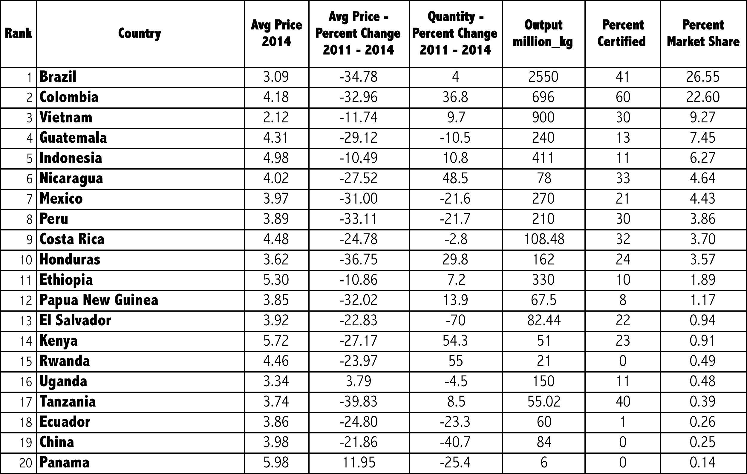
39 Countries

Slide 3
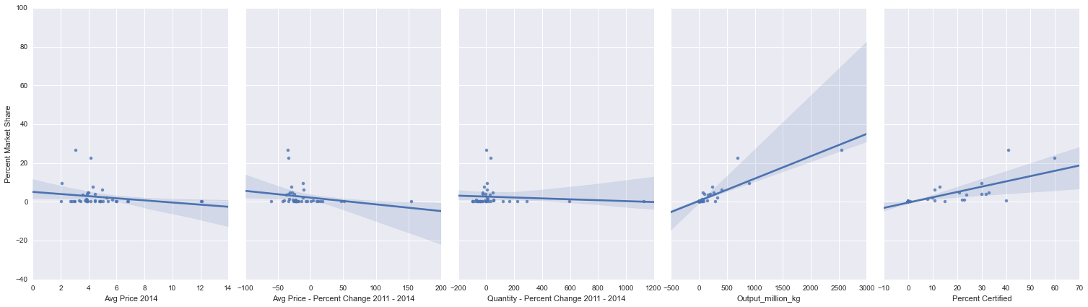
Avg Price 2014
% Change in Avg Price 2011-14
% Change in Quantity 2011-14

Slide 4
National Output 2014
Percent ‘Certified’

Slide 5
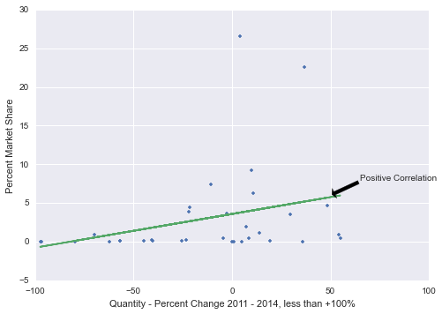

Slide 6
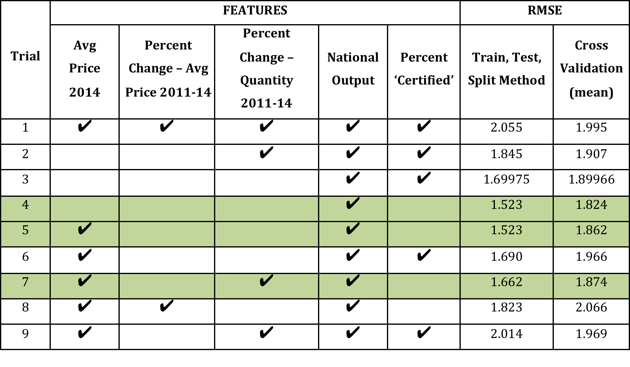

Slide 7
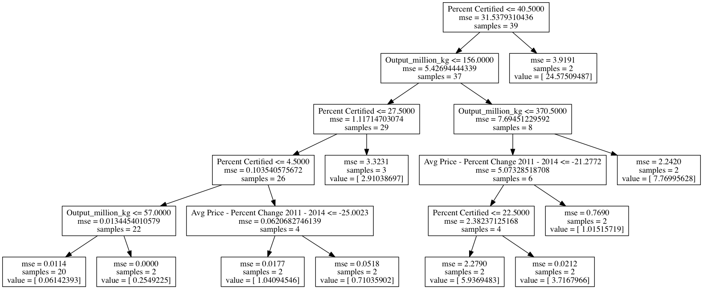

Slide 8
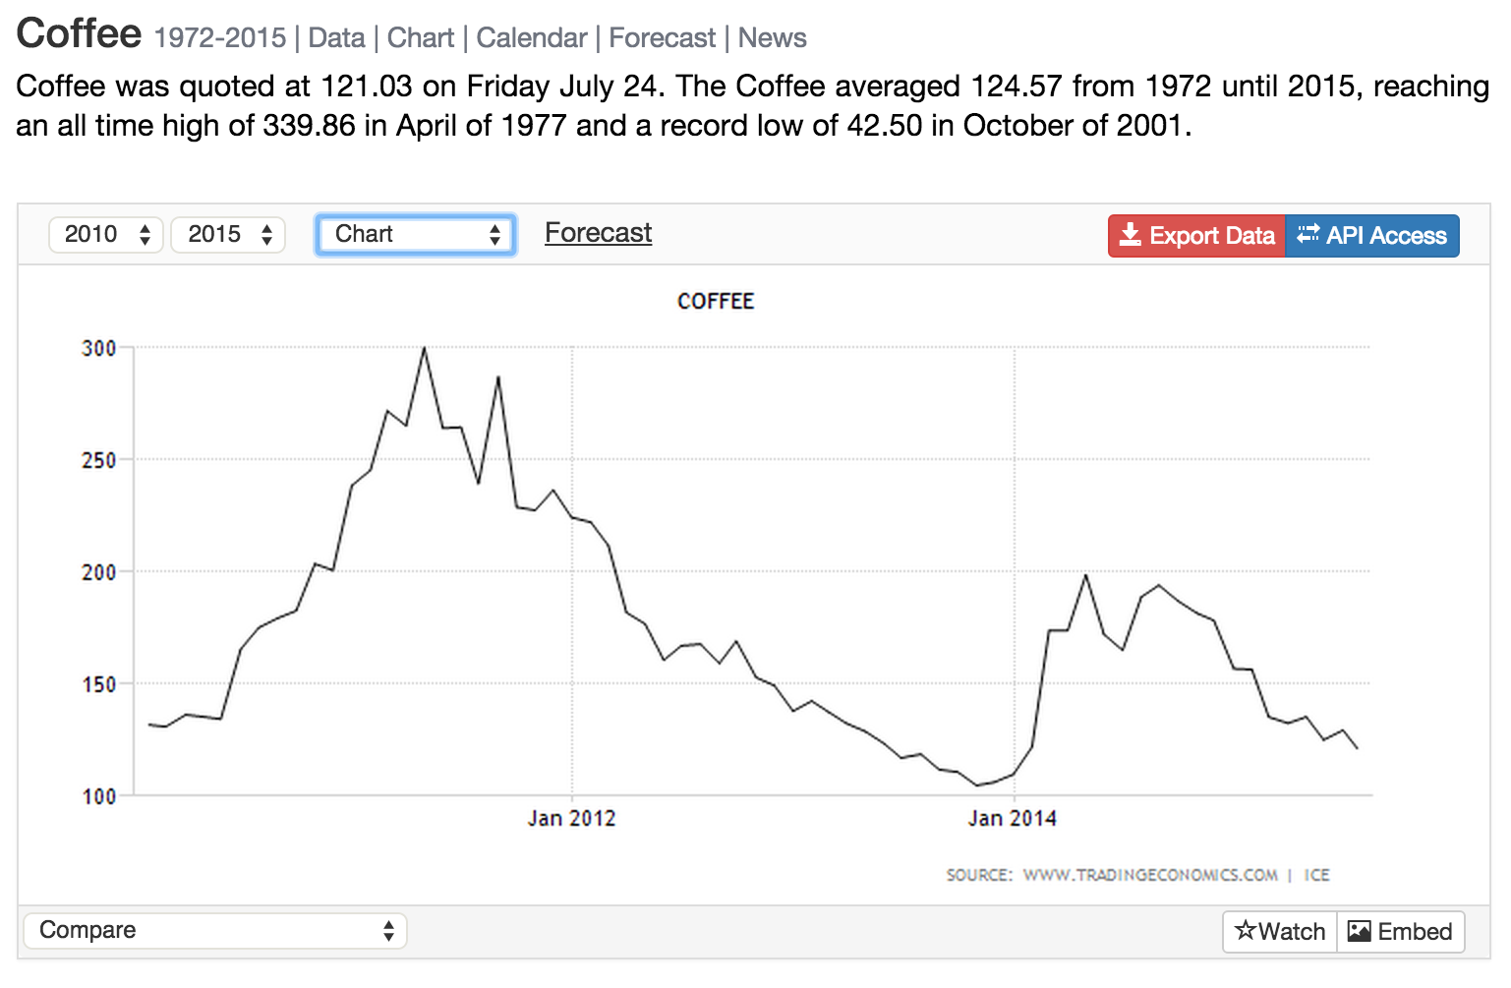
Challenges
+ Data Availability & Dominance of top 10 countries

